Slide 1

Project name: Social media campaign working
By: Kartik Jitendrakumar thakkar

Slide 2
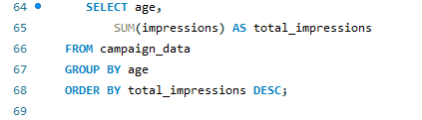

QUERY-1 . Which age group generated the highest total ad impressions across all campaigns.
Input output

Slide 3
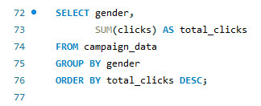

QUERY 2. Which gender produced the maximum number of total clicks
INPUT RESULT

Slide 4
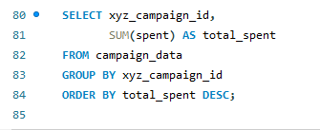
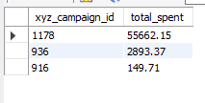
QUERY3.Which campaign had the highest total advertising spend?
INPUT
RESULT

Slide 5
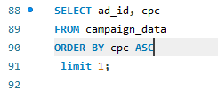

QUERY 4. Which ad has the lowest cost per click (CPC), indicating the most cost-efficient ad?
INPUT
RESULT

Slide 6


QUERY 5. What is the total number of approved conversions generated from all social media campaigns combined?
INPUT
RESULT

Slide 7
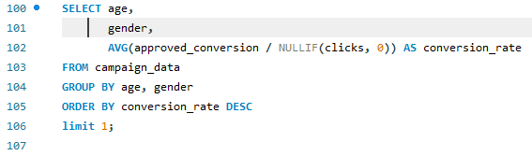

QUERY 6. Which age and gender combination has the highest conversion rate (approved conversions per click)?
INPUT
RESULT

Slide 8
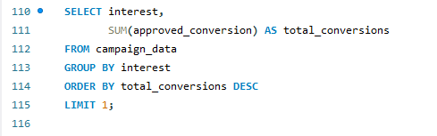

QUERY 7.Which interest category resulted in the maximum total approved conversions?
INPUT
RESULT

Slide 9
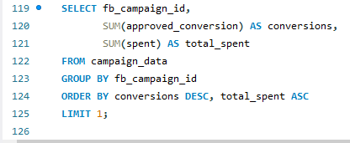

QYERY 8.Which campaign achieved the highest number of conversions, while also keeping the spend as low as possible?
INPUT
RESULT

Slide 10
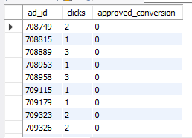
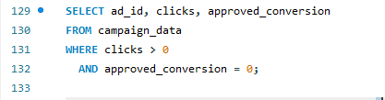
QUERY 9.Which ads received clicks but failed to generate any approved conversions, indicating poor landing page or targeting performance?
INPUT
RESULT

Slide 11
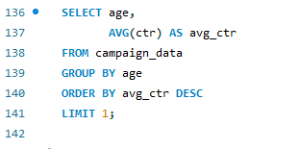

QUERY 10.Which age group has the highest average Click-Through Rate (CTR), showing better engagement?
INPUT
RESULT

Slide 12
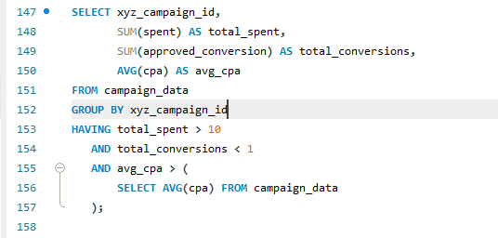

QUERY 11. Which campaigns are underperforming, defined as:-
High total spend
- Low conversions
- Higher than average cost per acquisition (CPA)*/
INPUT
RESULT

Slide 13
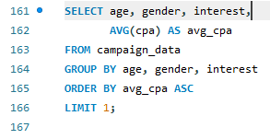

QUERY 12.Which age, gender, and interest combination delivers the lowest average CPA, making it the most cost-effective audience segment?
INPUT
RESULT

Slide 14
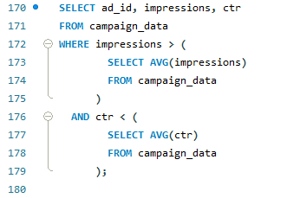
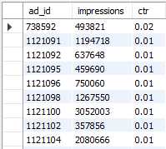
QUERT 13.Which ads have above-average impressions but below-average CTR, indicating visibility without engagement?
INPUT
RESULT

Slide 15
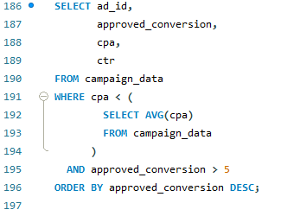
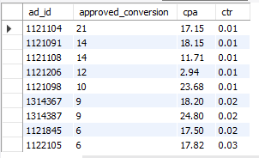
QUERY 14. Which ads perform efficiently, having:- Lower than average CPA - More than 5 approved conversions?
INPUT
RESULT

Slide 16
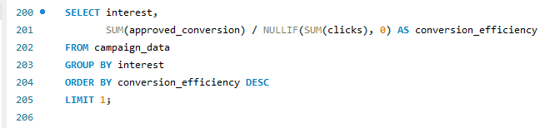

15.Which interest category has the highest conversion efficiency (approved conversions per click), making it the most valuable audience?
INPUT
RESULT

Slide 17
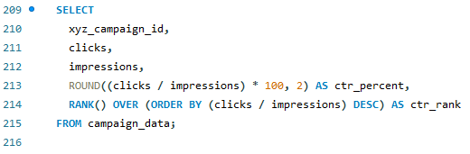
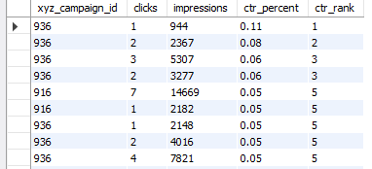
QUERY 16.Rank all campaigns based on their Click-Through Rate (CTR) to identify which campaign performed best in generating clicks from impressions.
INPUT
RESULT

Slide 18
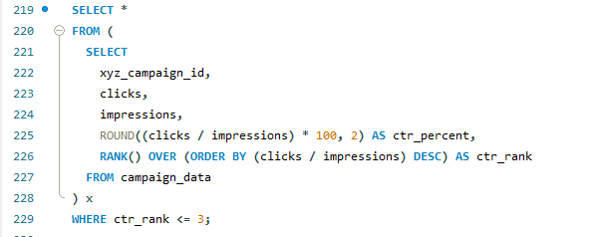

QUERY 17.Which campaigns are the Top 3 best performers based on CTR (Click Through Rate)
INPUT
RESULT

Slide 19


Thank you for watching this.

